Slide 1
Module 1

Slide 2
About Apache Spark Spark execution modes Basic Spark data structures (RDDs) Hands-on tutorial
▶ RDDs and operations
▶ DataFrames, User defined functions and SparkSQL
Hands-on lab exercises – Jupyter notebooks Hands-on lab exercise – Spark on an HPC
▶ Apache Spark deployment using Slurm
Independent work & debug session

Slide 3
On Apache Spark
Fast, expressive, general-purpose in-memory cluster computing framework compatible with Apache Hadoop and built around speed, ease of use and streaming analytics Faster and easier than Hadoop MapReduce* Large community and 3rd party libraries
Provides high-level APIs (Java, Scala, Python, R) Supports variety of workloads
▶ interactive queries, streaming, machine learning and graph processing

Slide 4
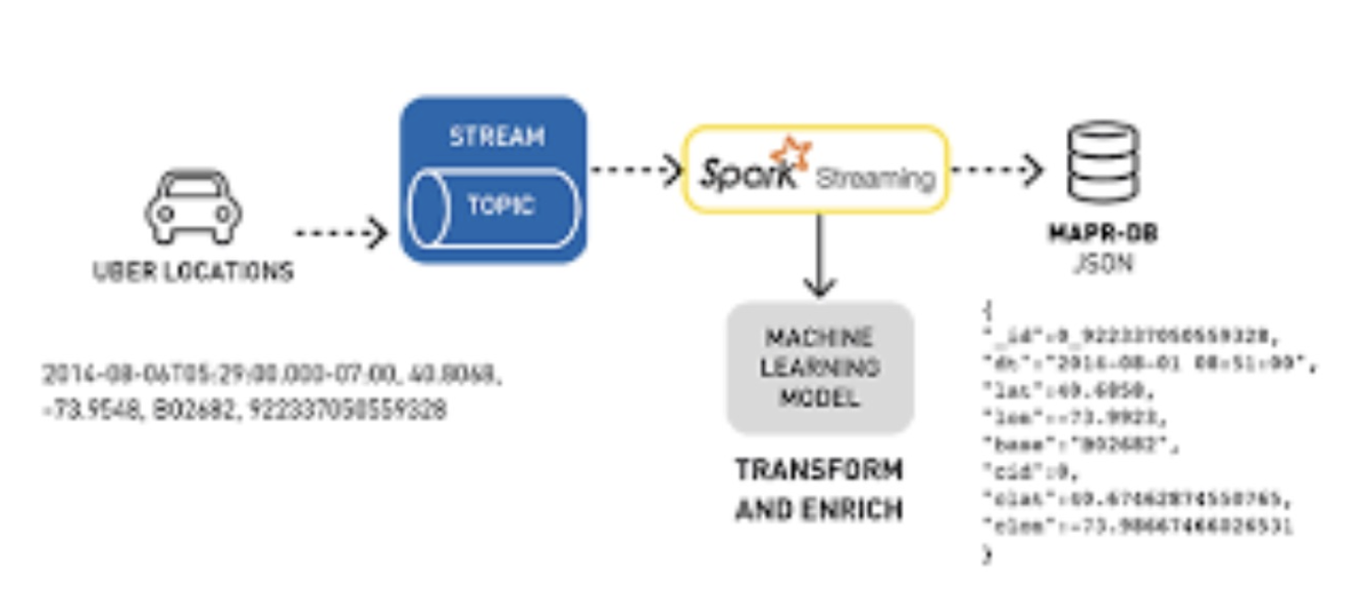
Spark Use-Cases
Logs processing (Uber)
Event detection and real-time analysis
Interactive analysis
Latency reduction
Advanced ad-targeting (Yahoo!)
Recommendation systems (Netflix, Pinterest)
Fraud detection
Sentiment analysis (Twitter)

Slide 5
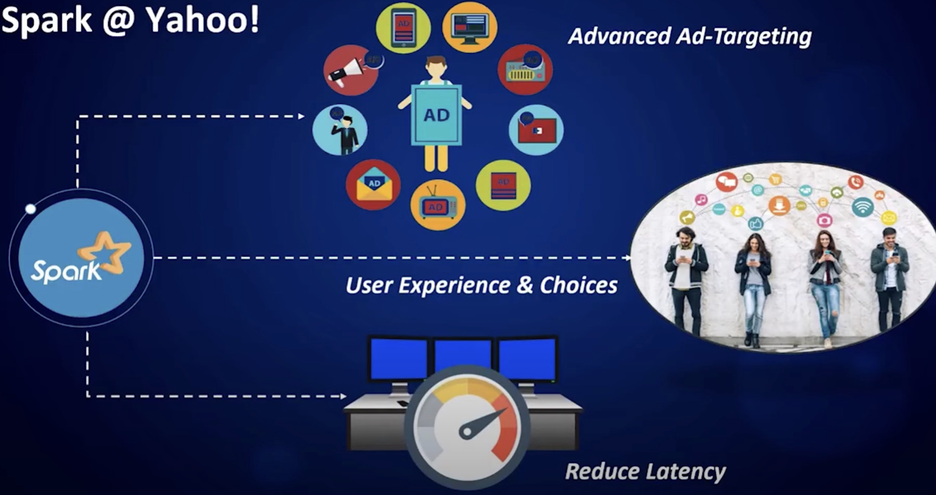
Spark Use-Cases
Logs processing (Uber)
Event detection and real-time analysis
Advanced ad-targeting (Yahoo!)

Slide 6
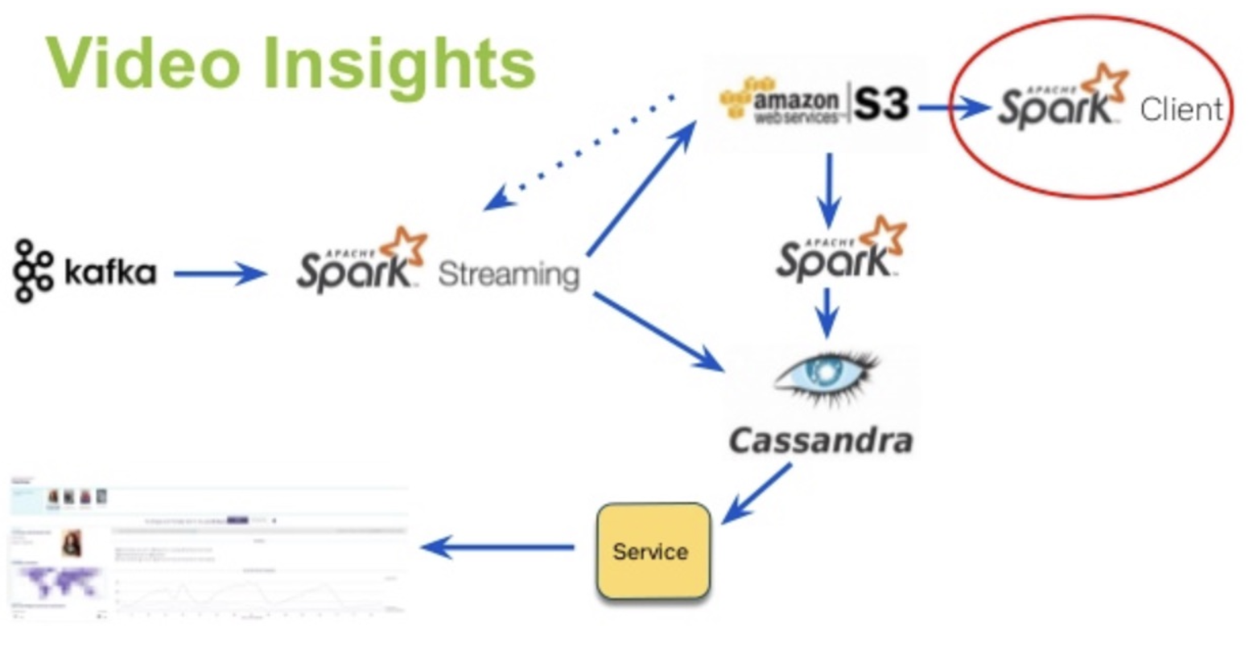
Spark Use-Cases
Logs processing (Uber)
Event detection and real-time analysis
Interactive analysis
Latency reduction
Advanced ad-targeting (Yahoo!)
Recommendation systems (Netflix, Pinterest)
Fraud detection
Sentiment analysis (Twitter)

Slide 7
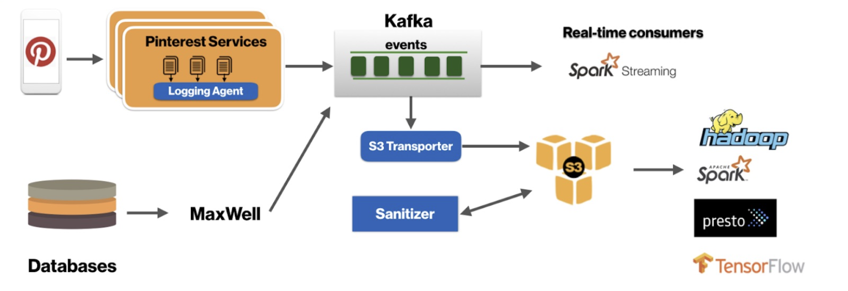
Spark Use-Cases
Recommendation systems (Netflix, Pinterest)
Fraud detection
Sentiment analysis (Twitter)

Slide 8
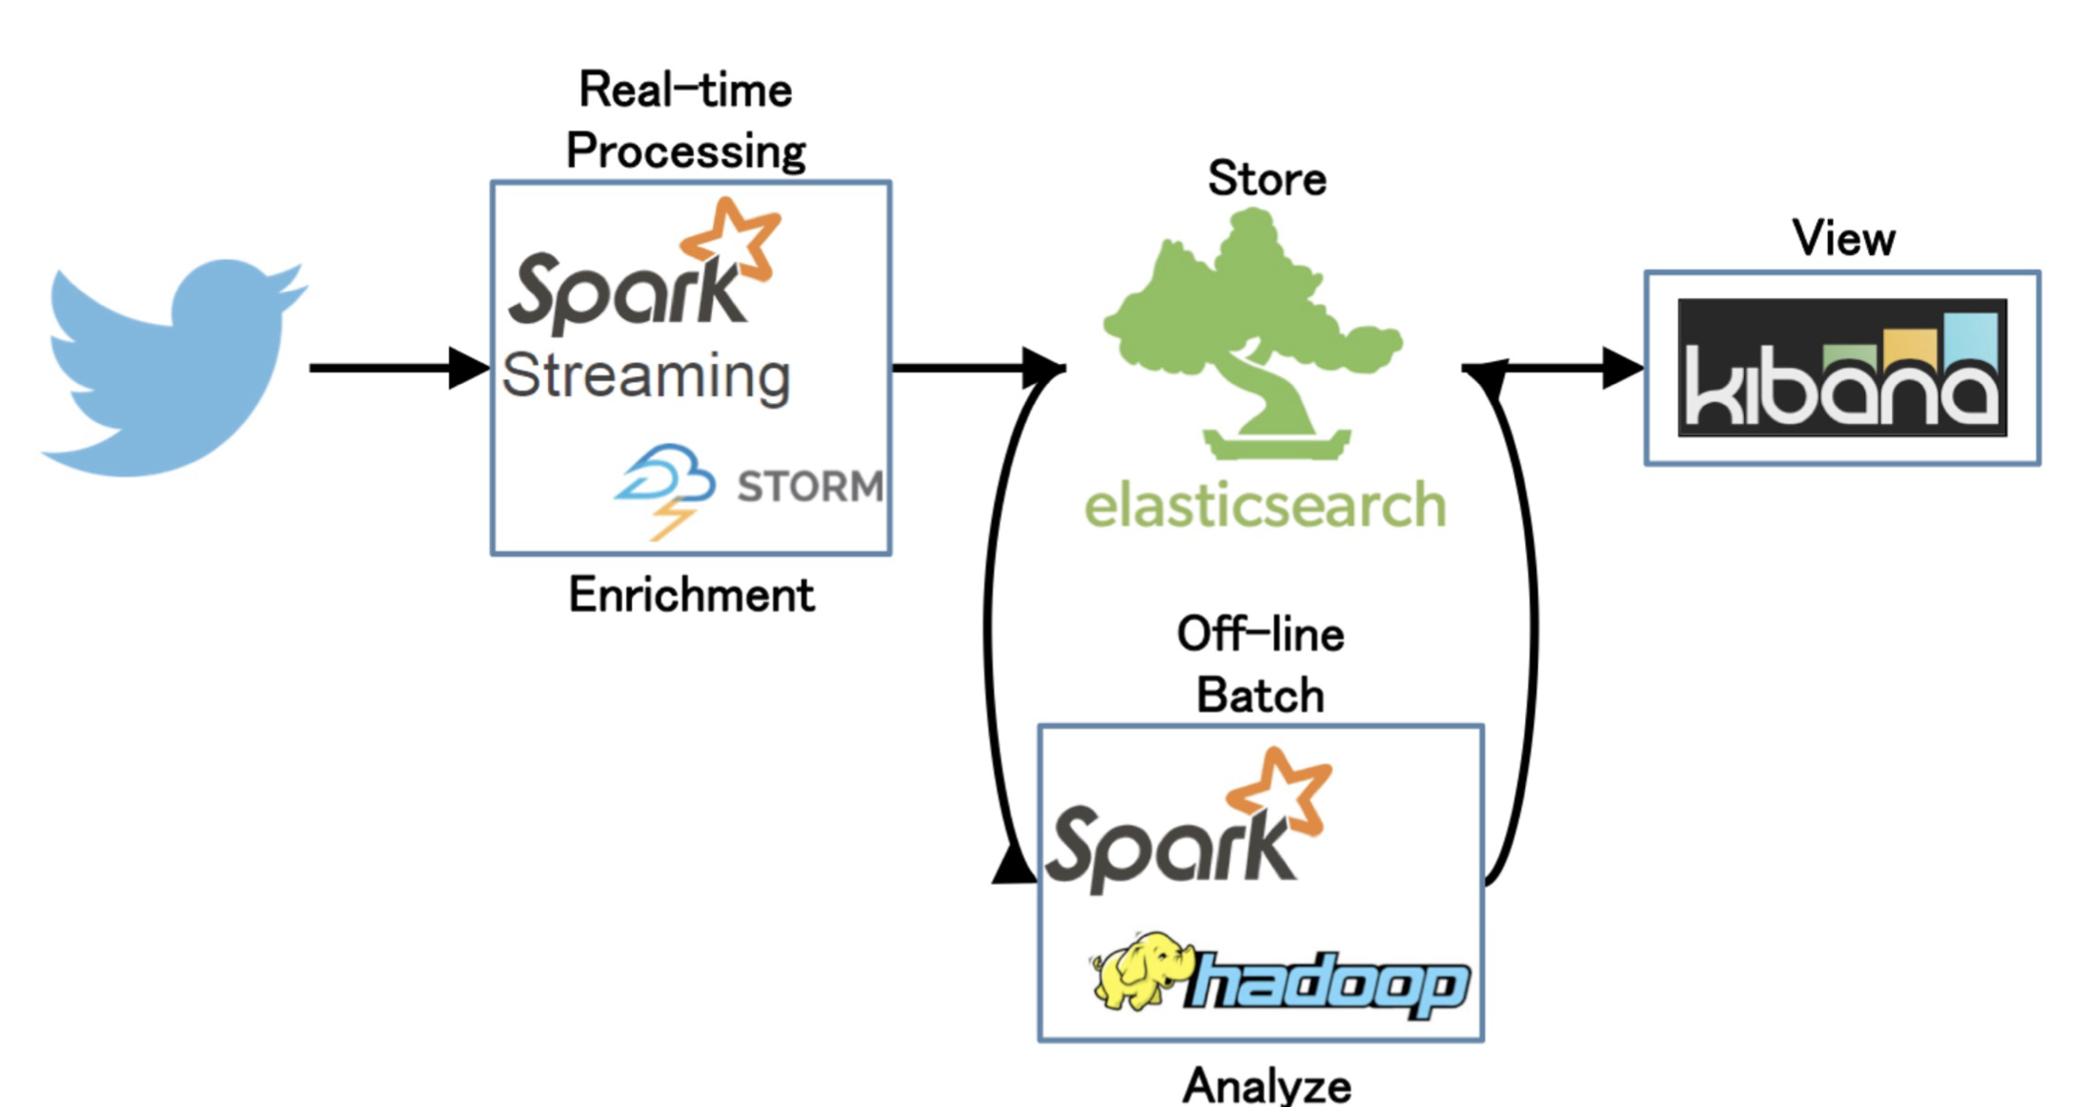
Spark Use-Cases
Sentiment analysis (Twitter)

Slide 9
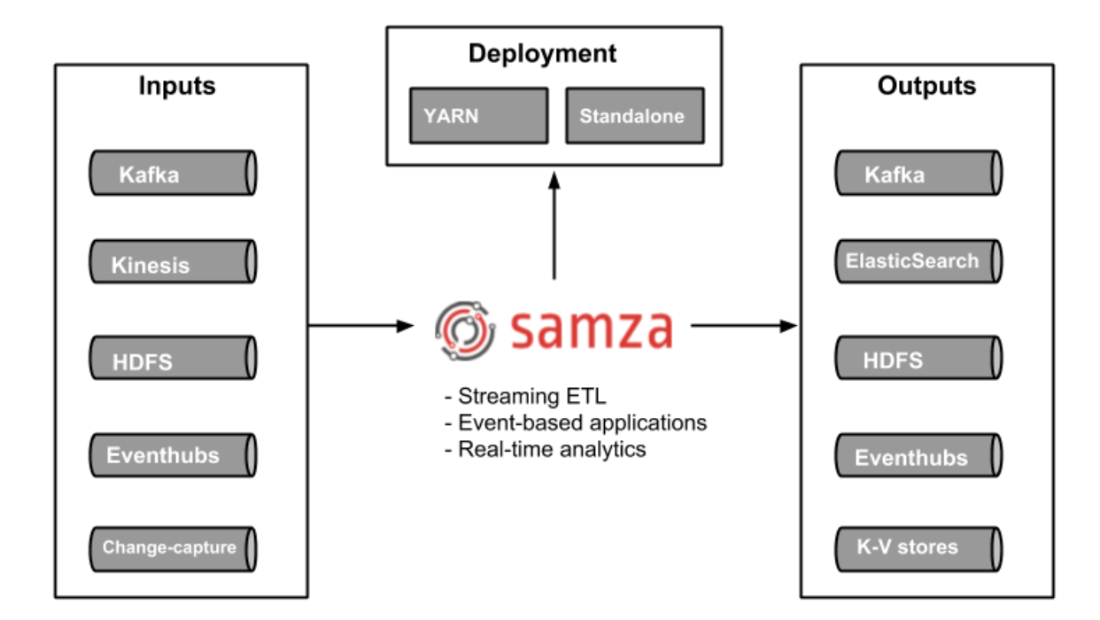
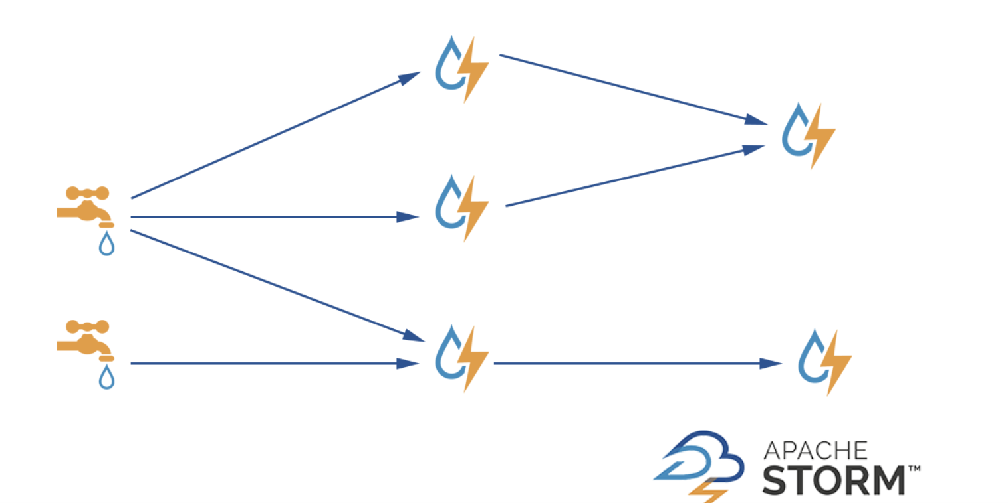
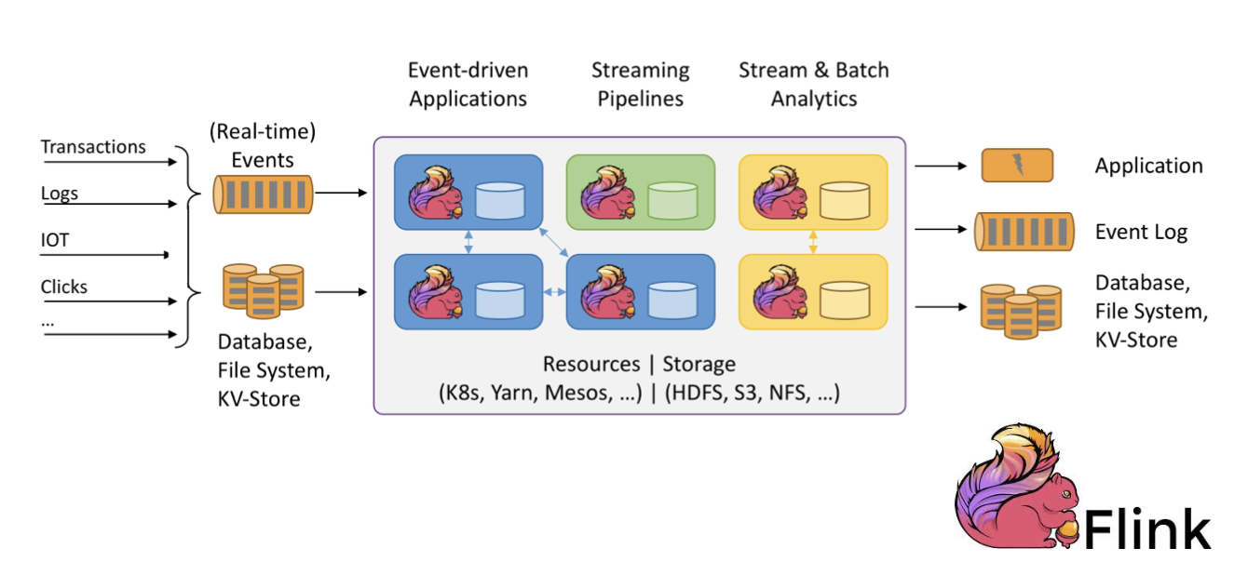
Apache Spark “real-time”
Apache Samza (library/framework)
Apache Storm (real-time stream processing)
Apache Flink (native streaming support for all workloads)

Slide 10
Apache Spark 3.x
Latest release – v3.1.1. (March 2, 2021)
Improvements over Spark 2 (v2.4.1)
▶ Python 2 deprecated
▶ Adaptive execution of Spark SQL (merging intermediate results among workers)
▶ Dynamic partition pruning
▶ Support for deep learning (GPU support for Nvidia, AMD, Intel)
▶ Better Kubernetes integration
▶ Graph features (Morpheus as extension of Cypher, neo4j support)
▶ ACID transactions (for Delta Lake storage)
▶ Apache Arrow data format integration (columnar format for analytics)

Slide 11
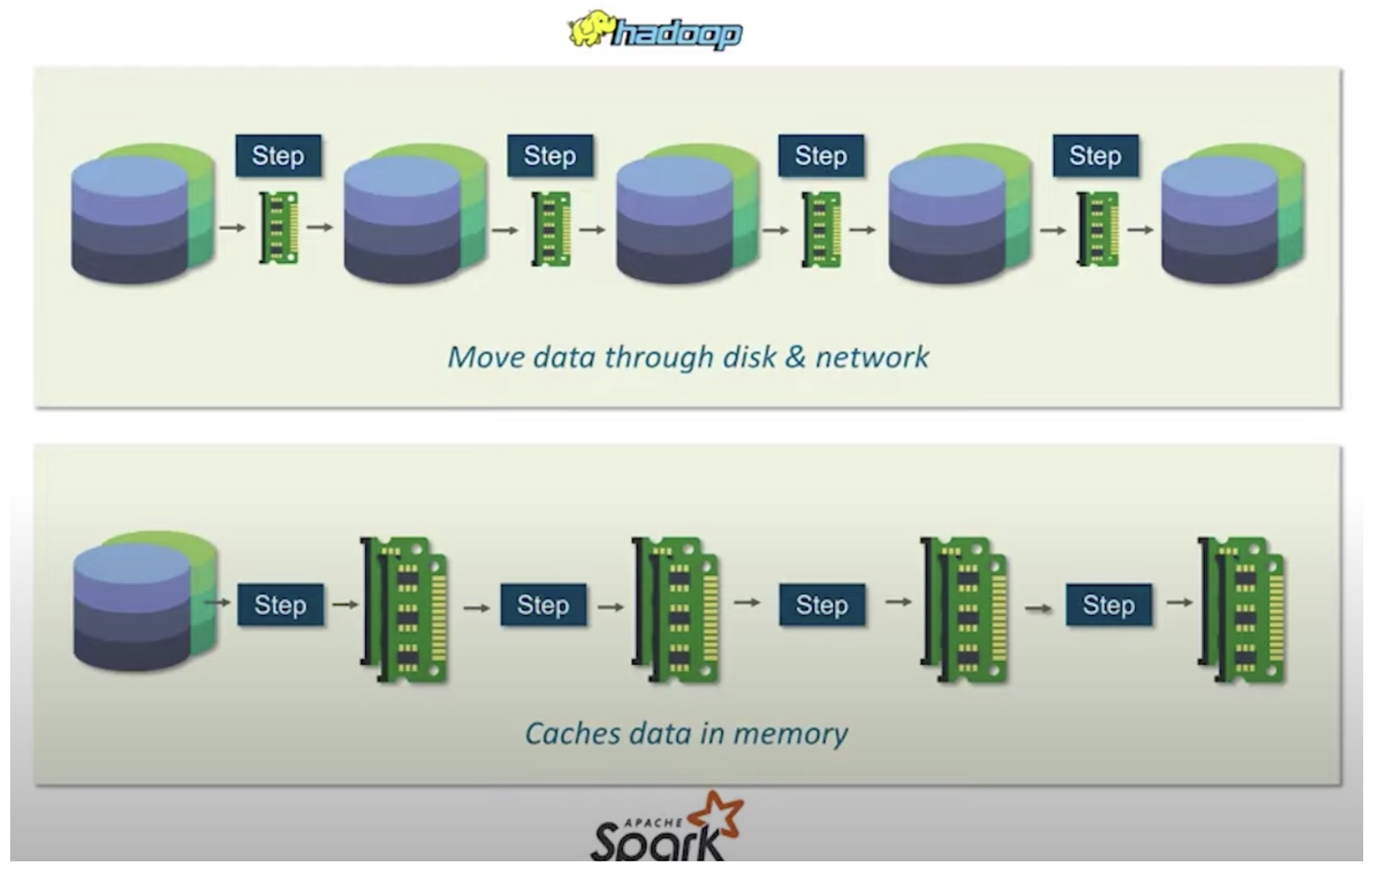
Hadoop MapReduce vs. Apache Spark
Big data frameworks
Performance
Ease of use
Costs
Data processing
Fault tolerance
Security
Hadoop
Archival data analysis
Spark
Real-time data analysis

Slide 12
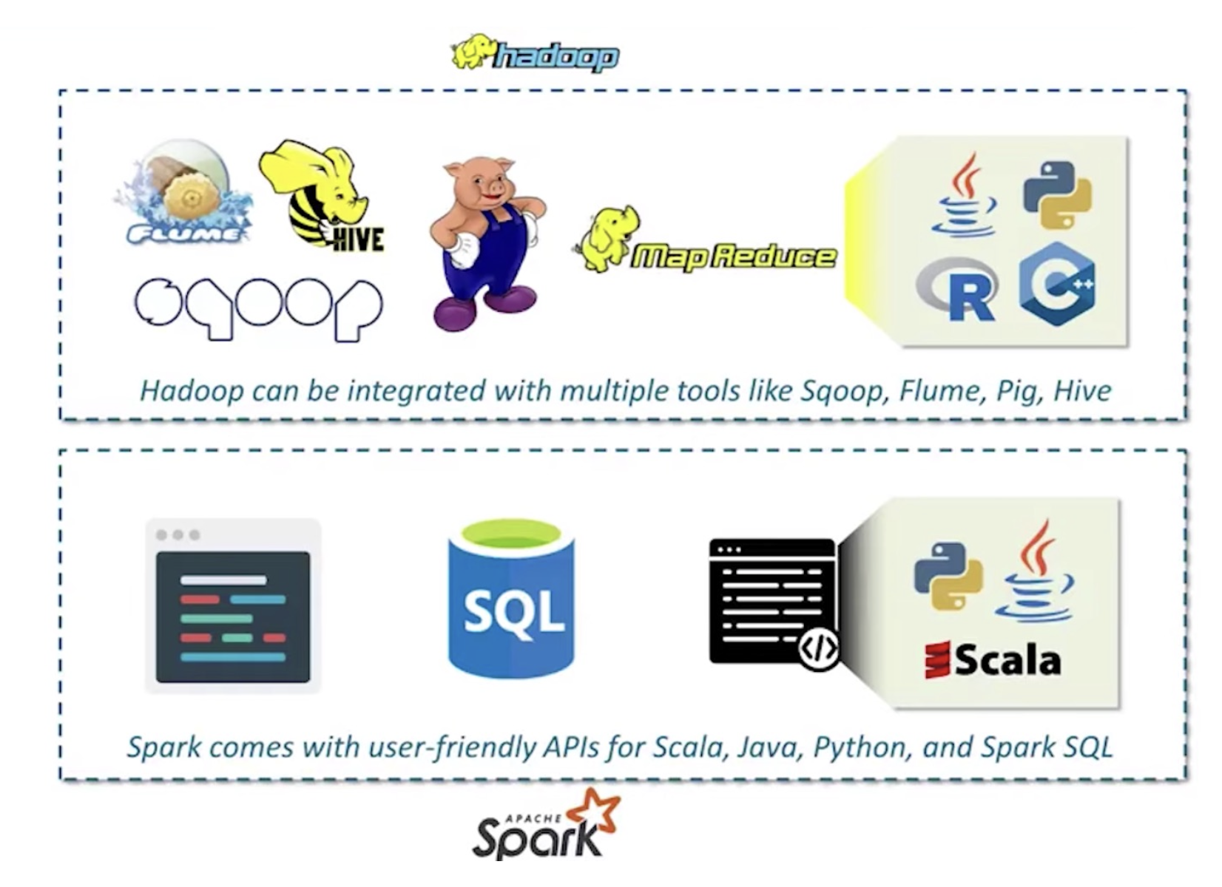
Hadoop MapReduce vs. Apache Spark

Slide 13
Hadoop MapReduce vs. Apache Spark

